Slide 1
Agribid
Online Marketplace for Farmers and
Bidders

Slide 2
Introduction
AgriBid is a Java web-based application designed to revolutionize the agricultural sector by promoting e-farming. It enables farmers to sell their products online through bidding, access innovative agricultural practices, and benefit from various government schemes.

Slide 3
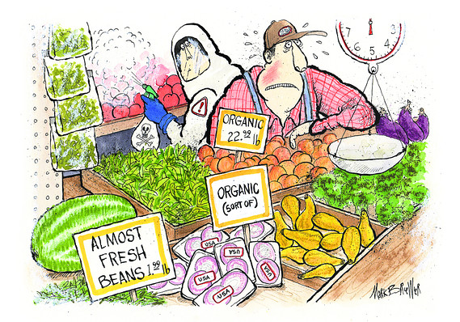
Problem statement
Farmers often face challenges in selling their products and accessing government schemes due to lack of awareness and traditional practices. Agribid aims to bridge this gap by providing an online platform for bidding and scheme benefits, thereby increasing farmers’ productivity and profits.

Slide 4
System Requirements
RAM 4gb and above
Visual Studio code
Internet connection
Windows 10 or later, macOs or linux
JDK 17
Eclipse Enterprise Edition
MySQL 5.7

Slide 5

Technologies
Backend Technologies
Frontend Technologies​
Java 17
Spring Boot Microservices
JPA
My SQL
JUnit Testing
Angular 18
HTML5
CSS
BootStrap

Slide 6

Project Users
Farmer
Bidder
​
Farmer Registration
Farmer Login
Farmer Homepage
Place Crop Request
View Sold History
View Market Place
Apply for Insurance
Bidder Registration​
Bidder Login​
Bidder Homepage​
Bid for Crops
Wins bidding​

Slide 7
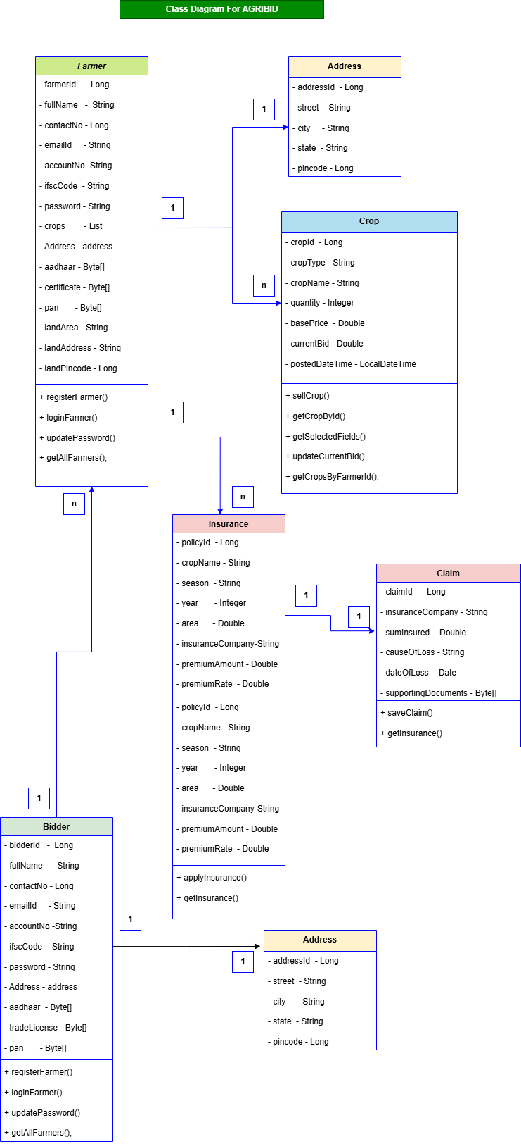
Class Diagram

Slide 8
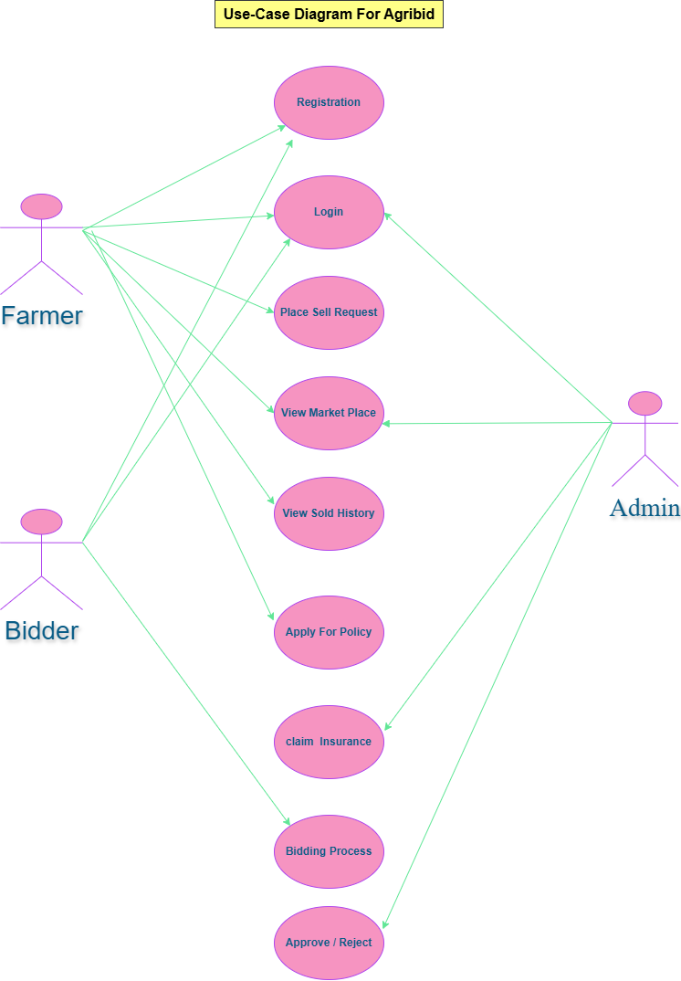
Use Case Diagram

Slide 9
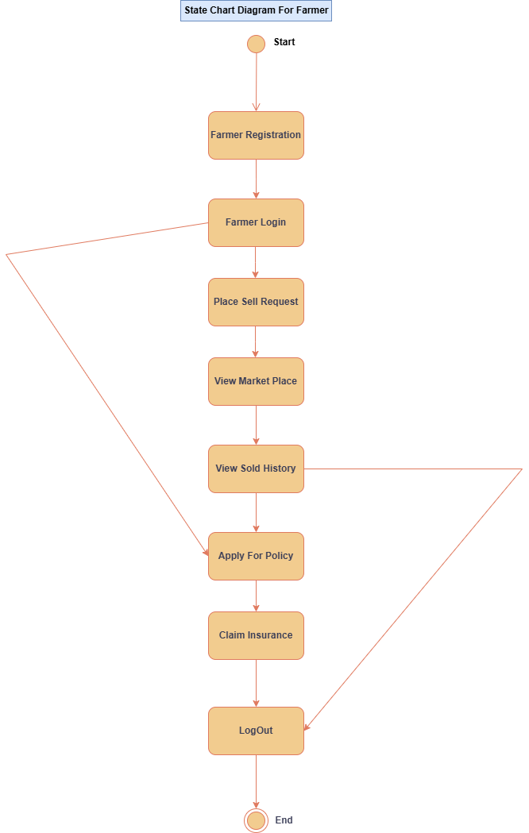
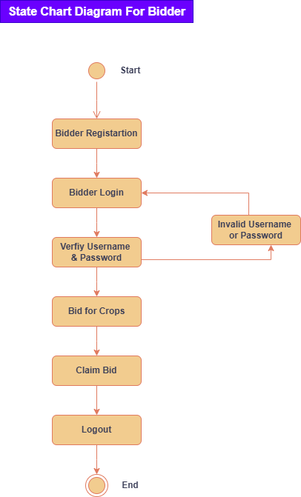
State Diagram

Slide 10
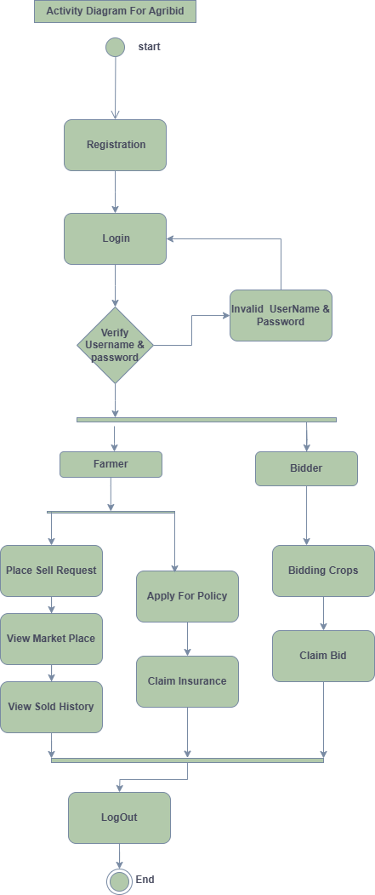
Activity Diagram

Slide 11

Screenshots of Our Project
"AGRIBID"​

Slide 12
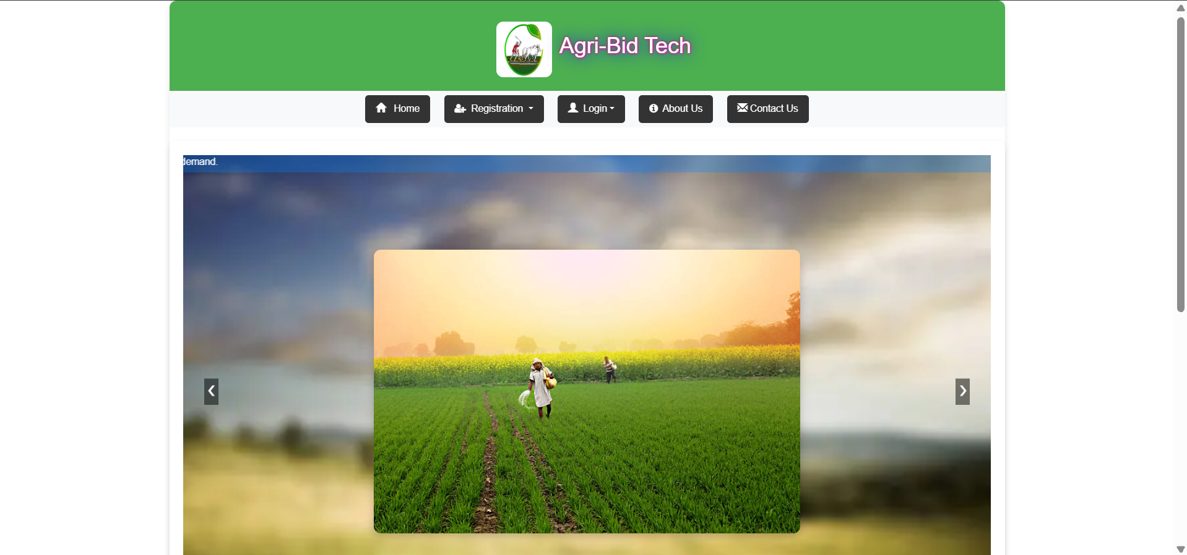
AgriBid Home page

Slide 13
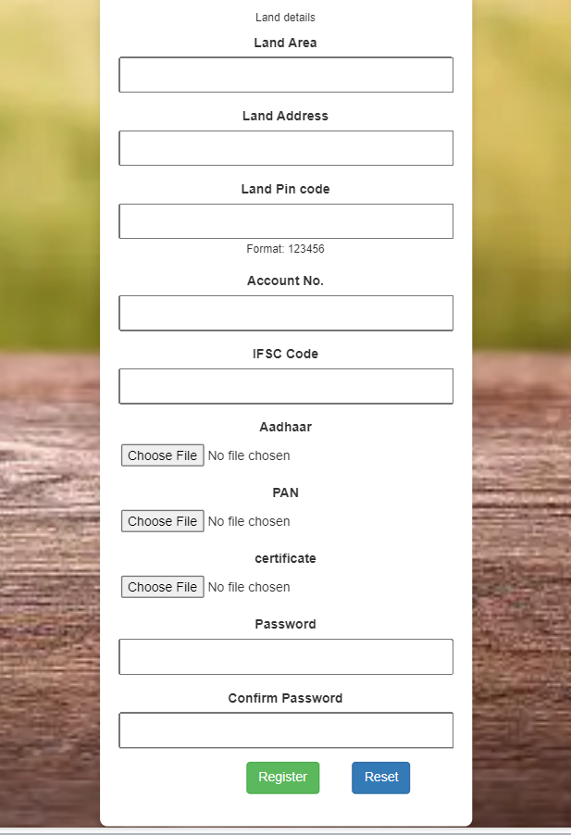
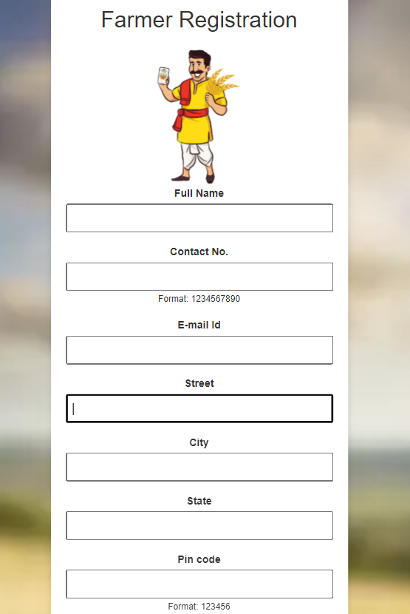
Farmer Registration page

Slide 14
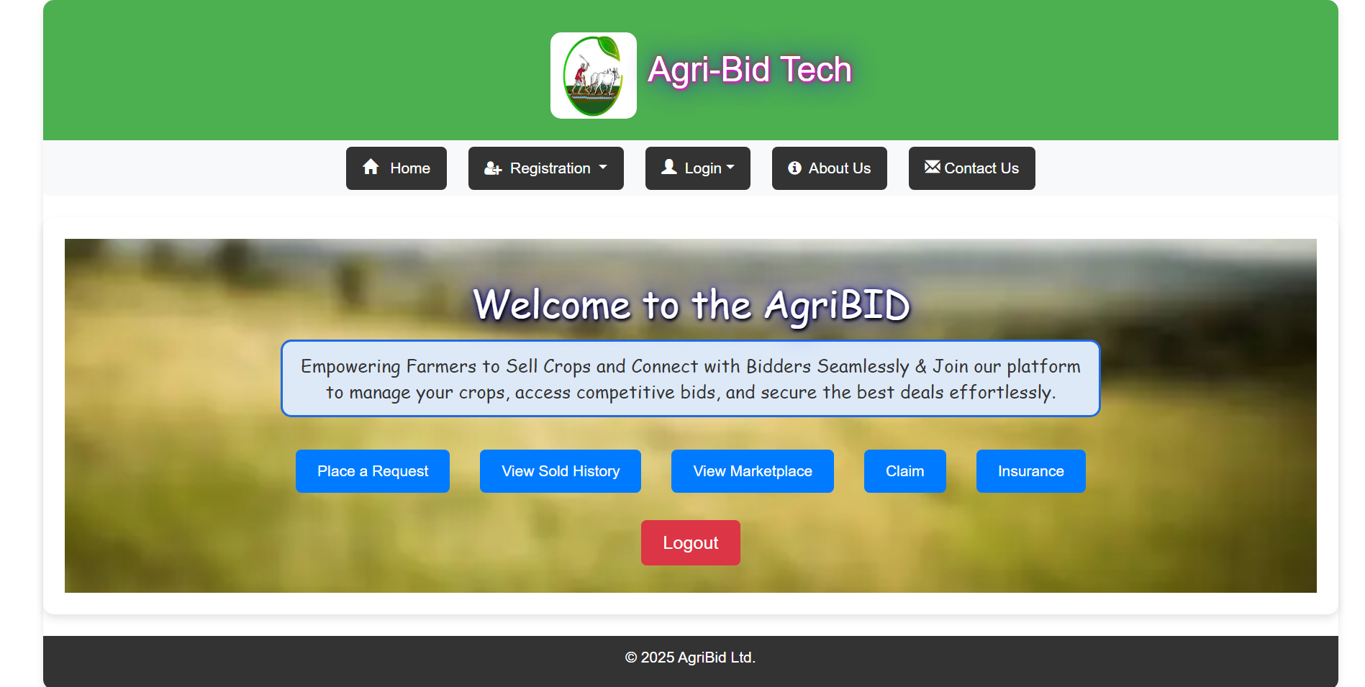
Farmer Home page

Slide 15
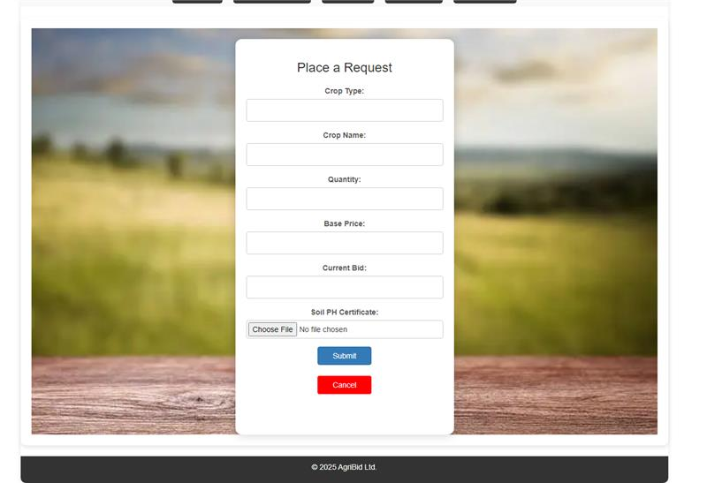
Place Crop request

Slide 16
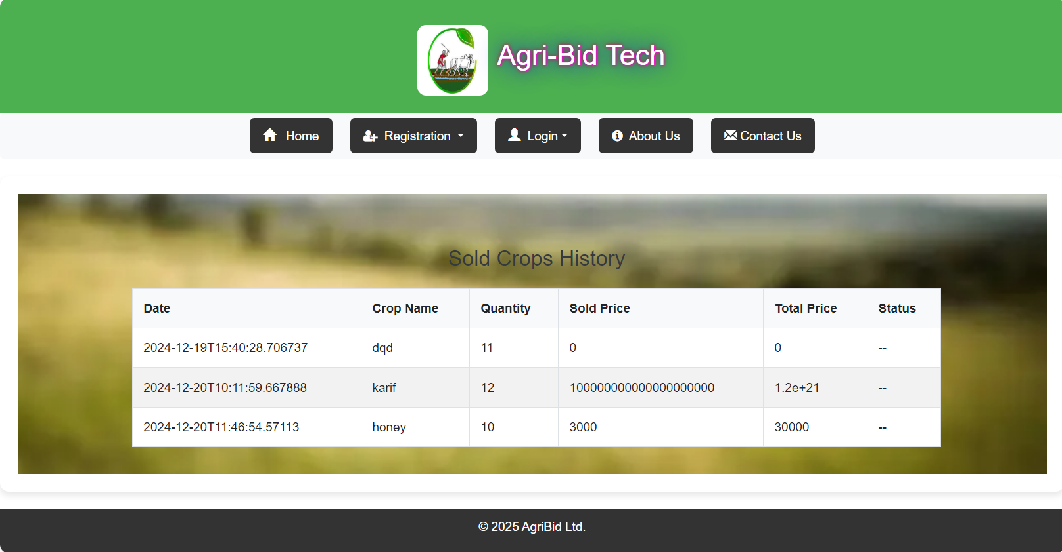
View Sold History

Slide 17
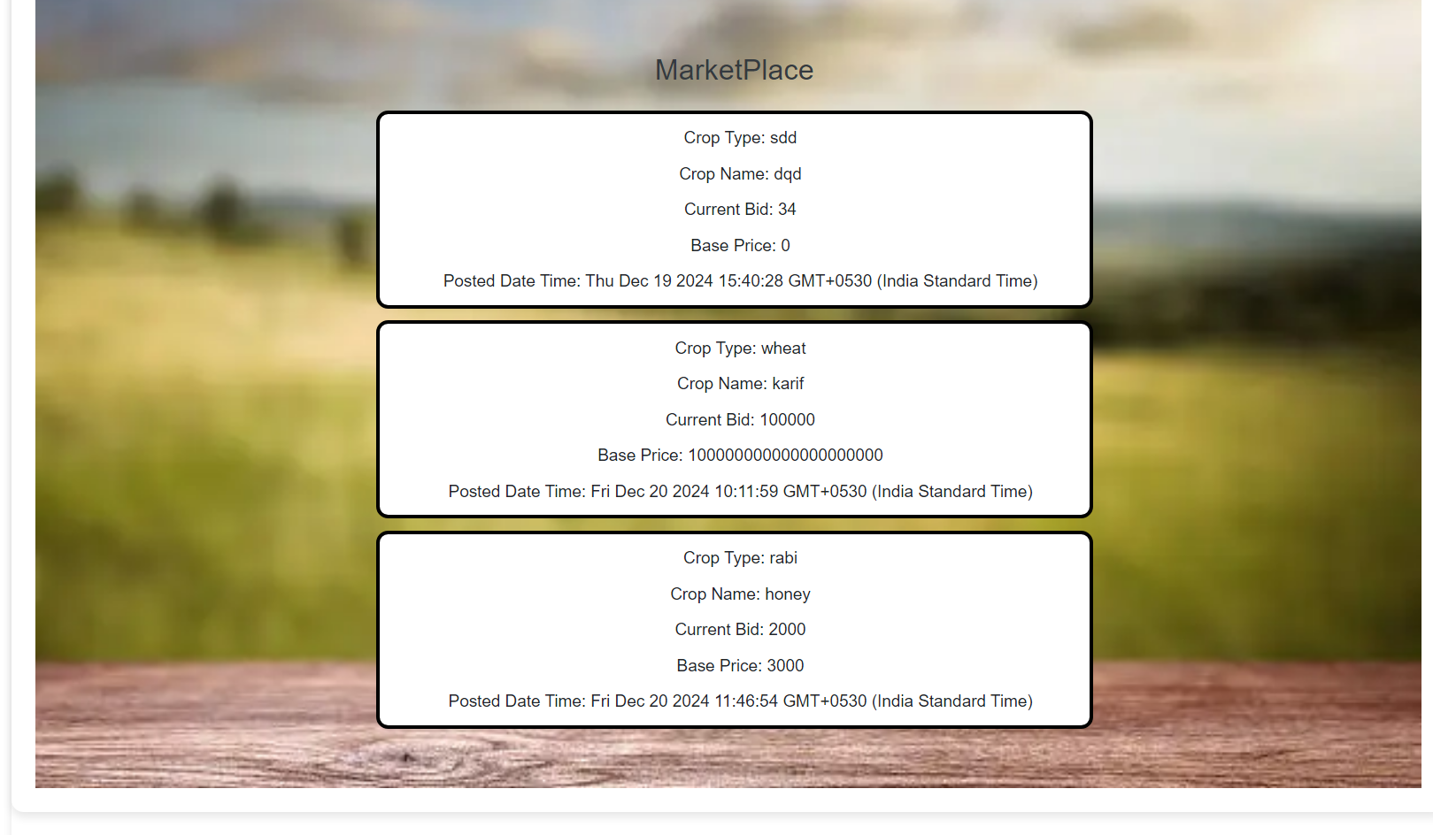
View Market place

Slide 18
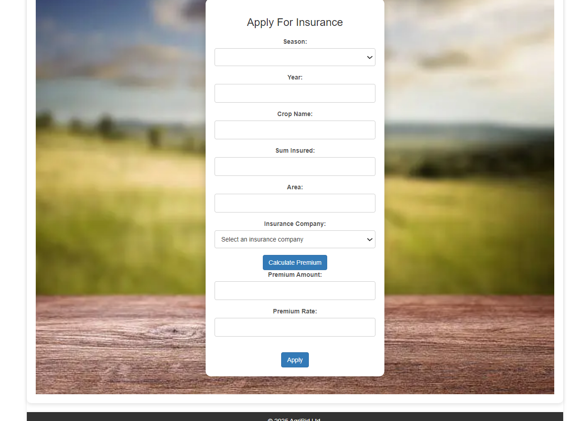
Insurance

Slide 19
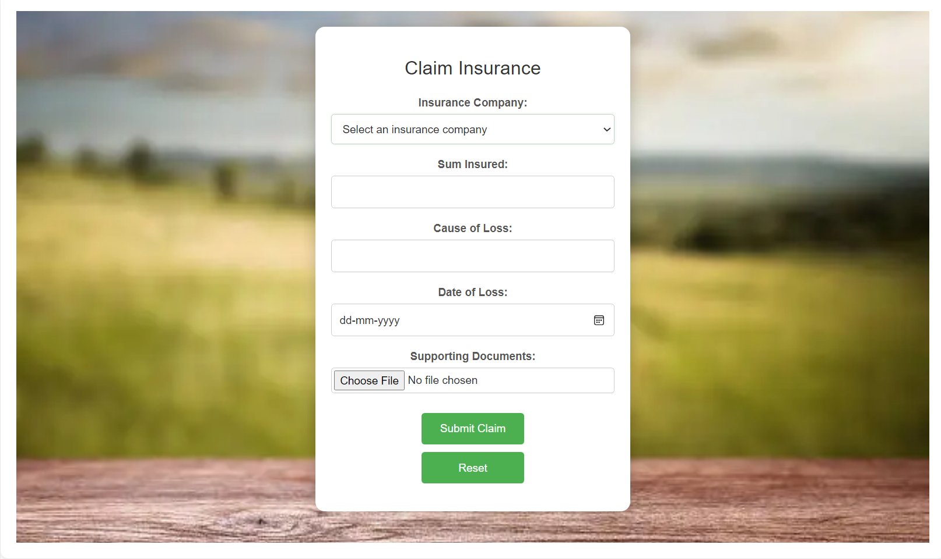
Claim Insurance

Slide 20
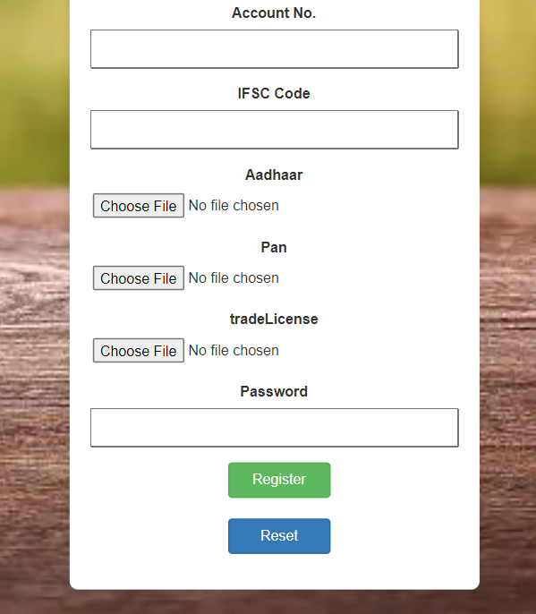
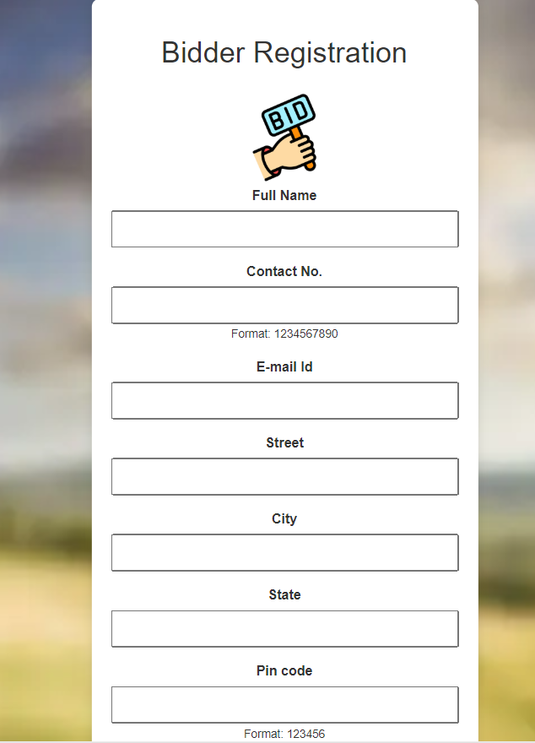
Bidder Registration Page

Slide 21
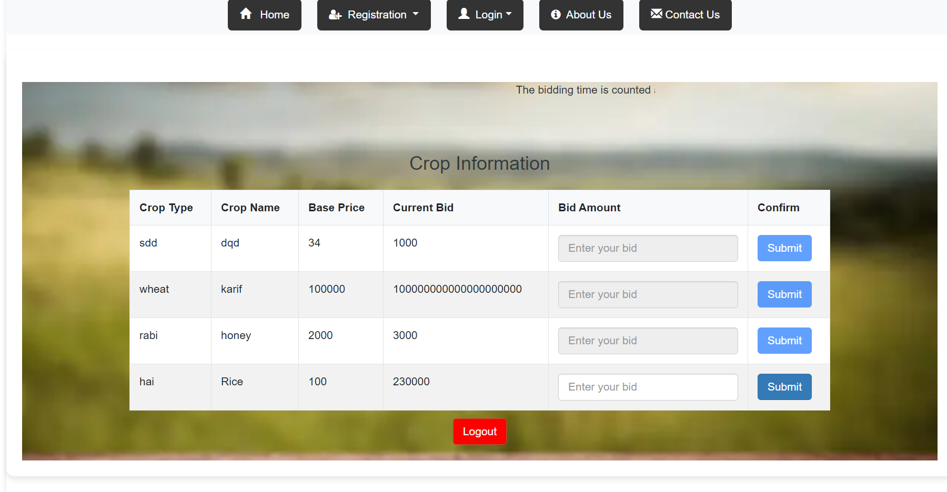
Bidder Home Page

Slide 22
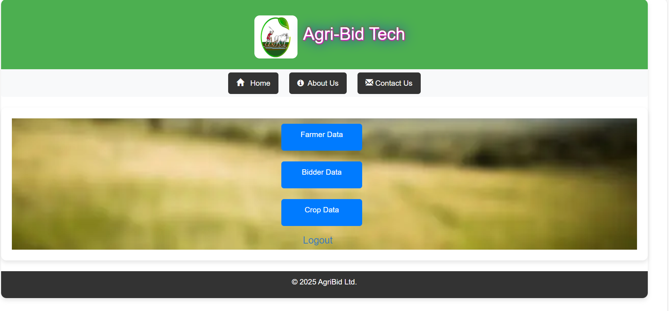
Admin Home Page

Slide 23
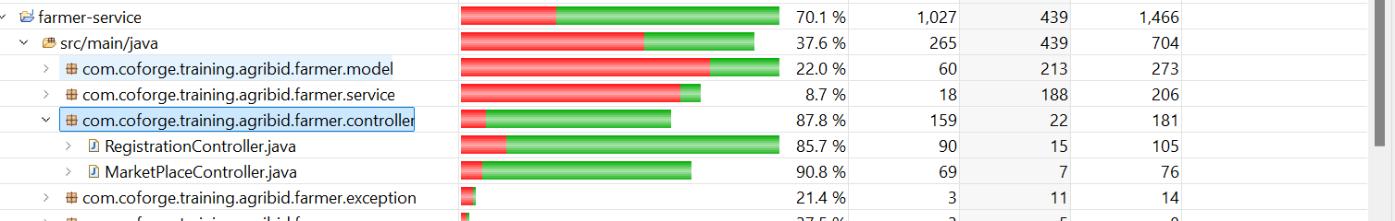
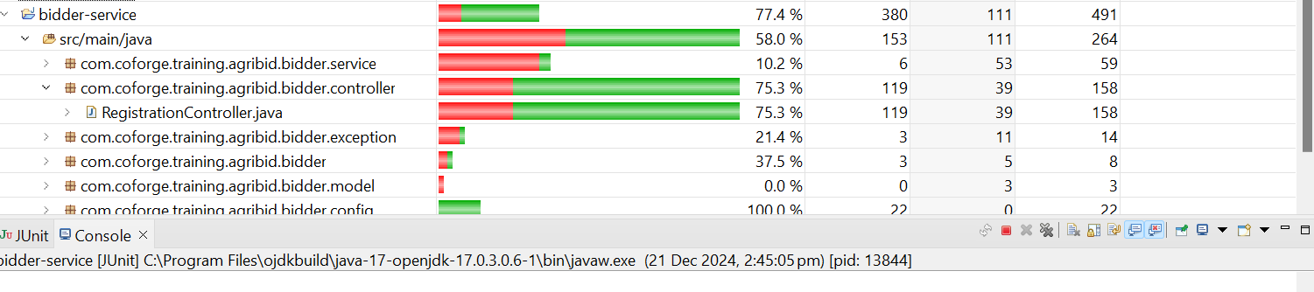
Farmer-service testing coverage
Bidder-service testing coverage

Slide 24

Thank you
By:
K. Ajay M. Chandu P. Rohit K. Sruthi

